Slide 1

Tableau project
By Avinash A Godi
B.E. (MECHANICAL)

Slide 2
This project is based on superstore data across the globe
This dataset contains 23 columns and 601 rows
From this dataset the fields used as follows:
Row ID, Order ID, Order Date, Ship Date, Ship Mode, Customer ID, Customer Name, Segment City, State, Country, Market, Region, Product ID, Category, Sub-Category, Product Name, Sales, Quantity, Discount, Profit, Shipping, Cost, Order Priority .

Slide 3
PROBLEM STATEMENTS
1. Weekly Quantity Info using Dynamic Reference
2. Segment Wise Info using Dynamic Measure
3. Customer Info using Dynamic Scatter
4. Subcategory Info using Top N
5. State Wise Info using Dynamic Map
6. Dual Axis Chart (profit and sales in regions)

Slide 4
BASIC ANALYSIS CHARTS

Slide 5
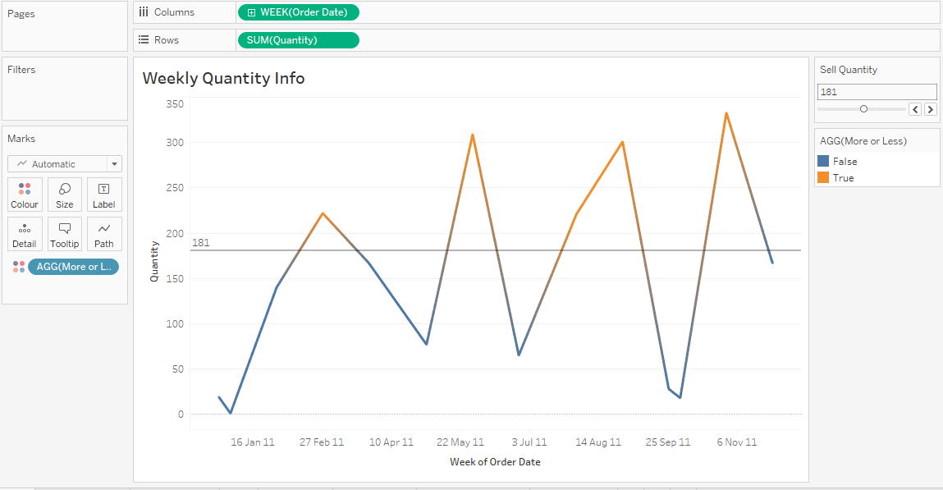
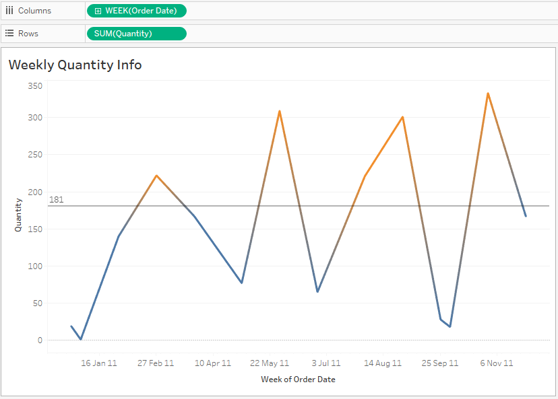

Slide 6
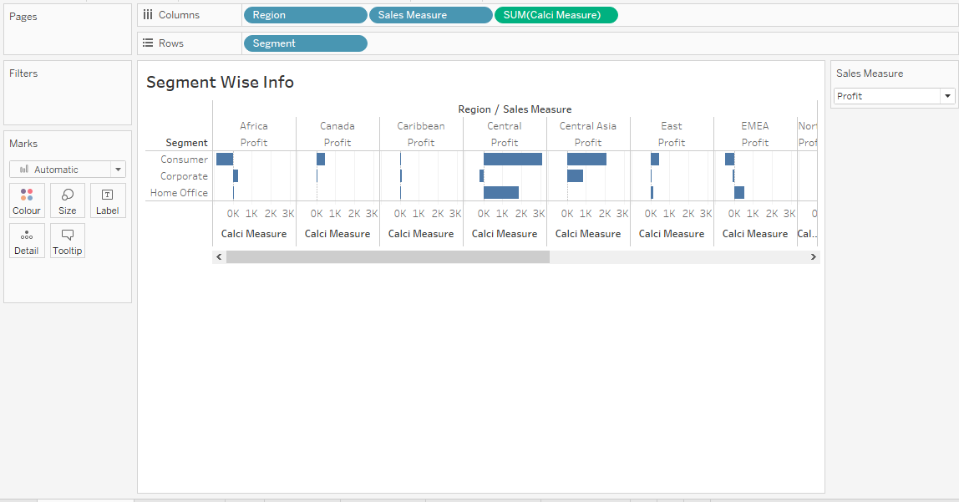
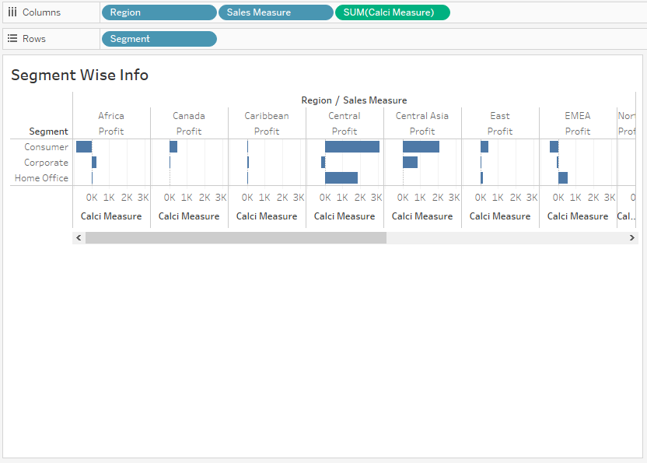

Slide 7
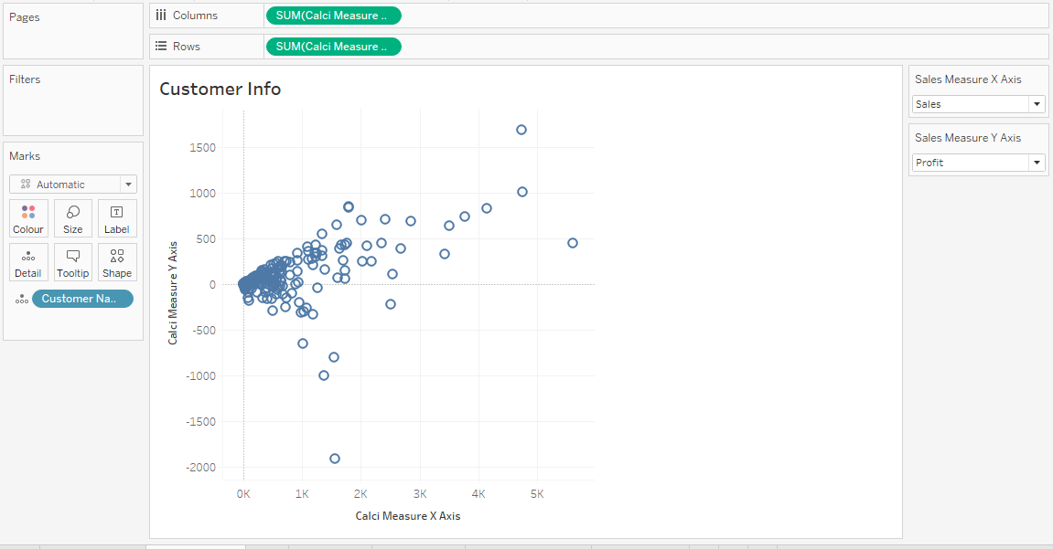

Slide 8
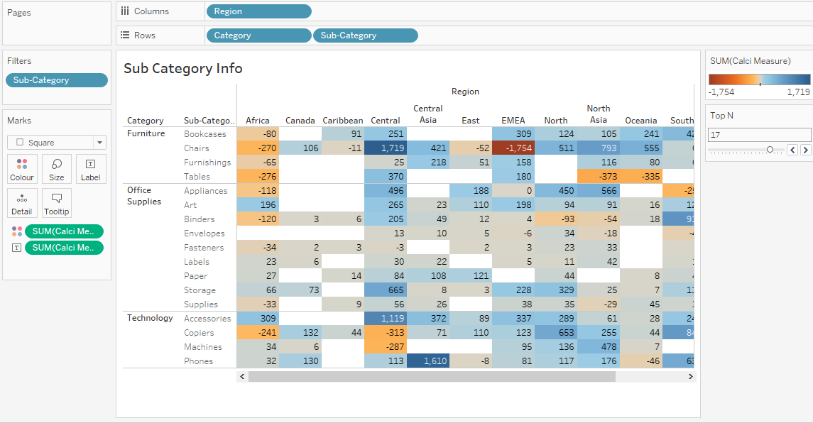

Slide 9
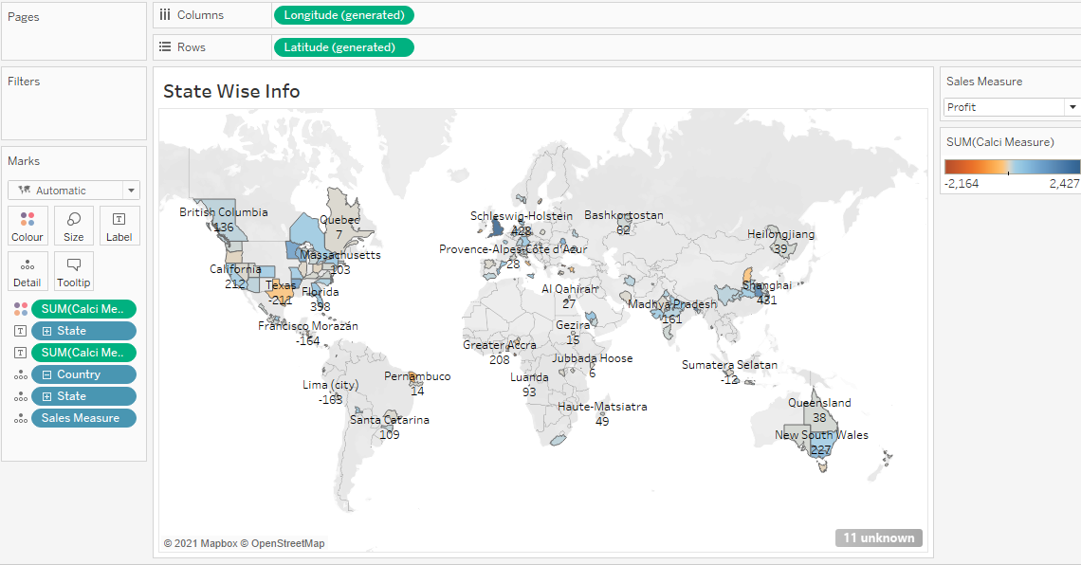

Slide 10
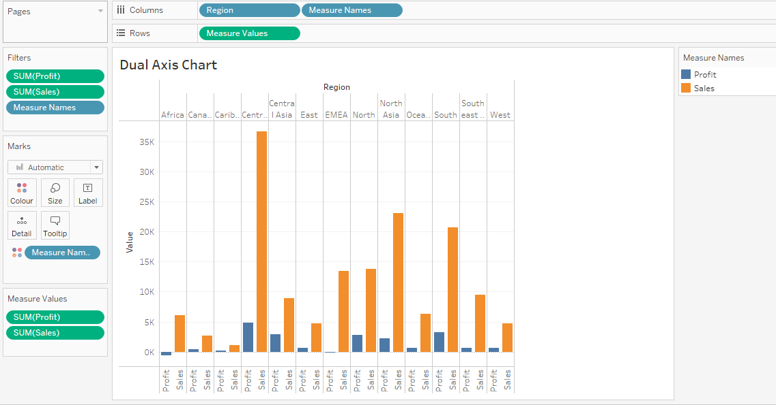

Slide 11
EXECUTIVE SUMMARY(Final Dashboard)

Slide 12
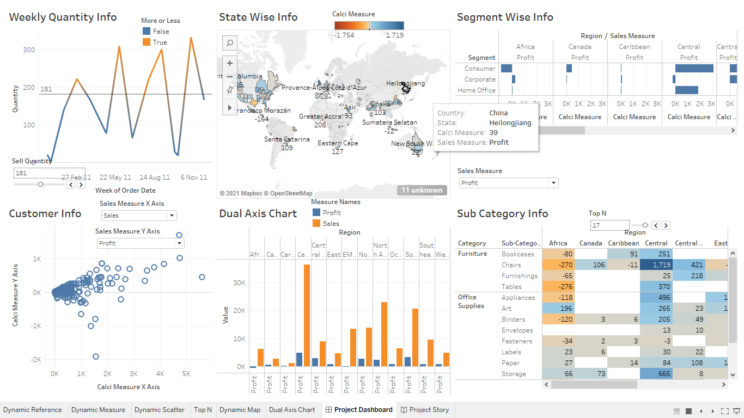

Slide 13
CONCLUSION
The final dashboard and story is created from the dataset.

Slide 14
Data source
Dataset link
https://www.kaggle.com/jr2ngb/superstore-data
Video Presentation link
https://drive.google.com/file/d/11nbZqehK9S25yHuukXFtNtBymLxPaDab/view?usp=drivesdk

Slide 15
THANK YOU

